Slide 1
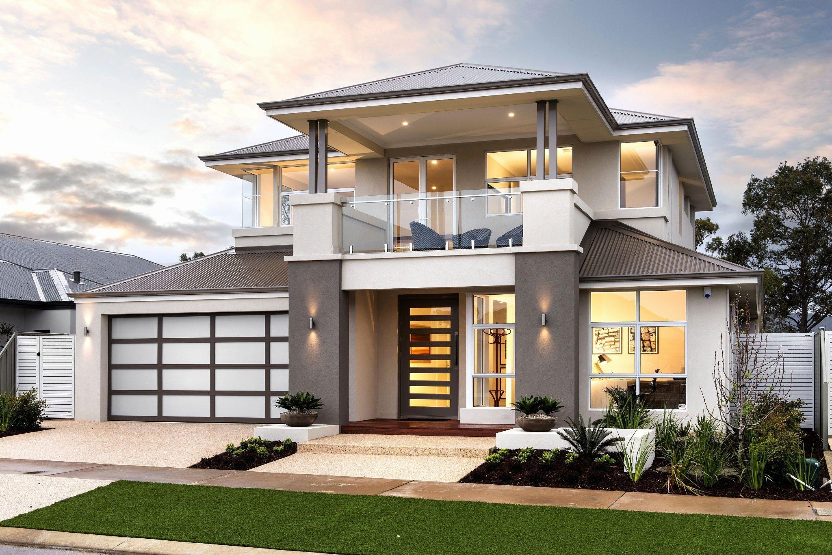

Imali.biz Smart App
“We Provide easy Transaction in real Estate investments. “
>
Imali.biz 2021

Slide 2
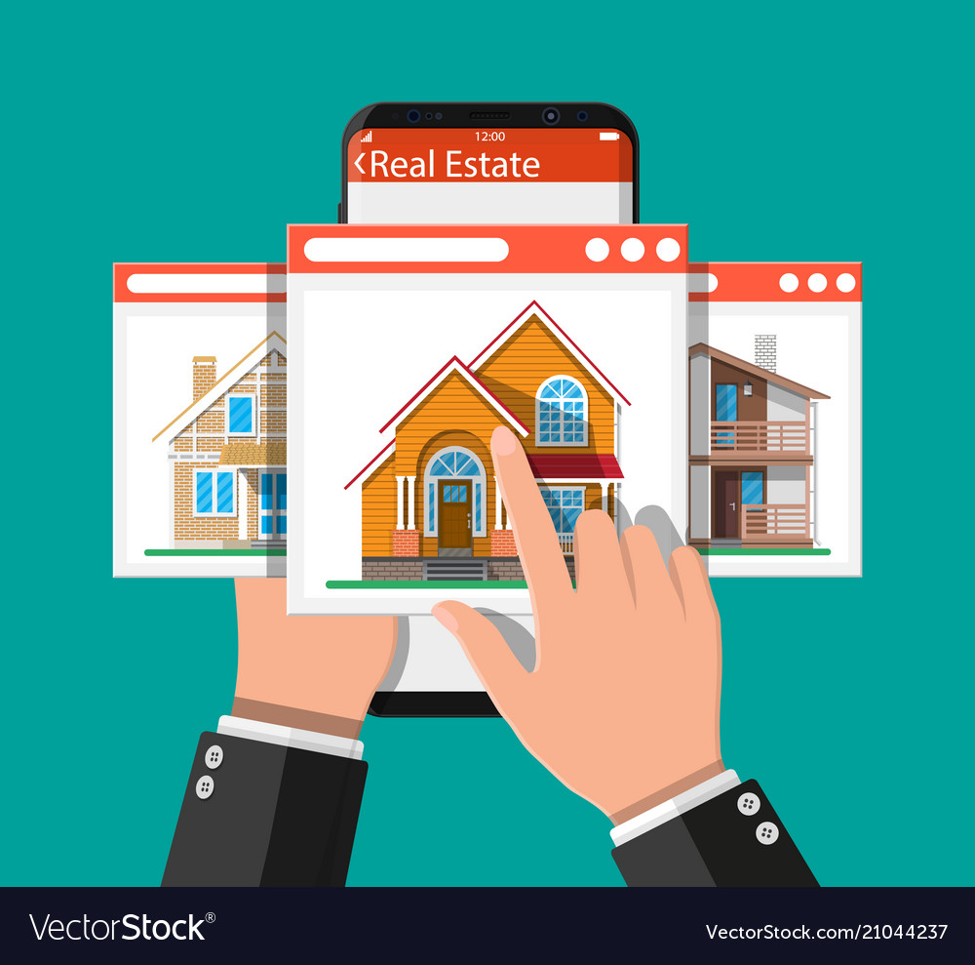


Is a digital Marketplace that connect buyers and sellers of properties and various appliances
We want Imali to be an ecosystem that connects all key stakeholders in real estate using “ Smart App” to unlock the potential of real estate in Rwanda.
We discovered that 90% of our target customers are interested in real estate.
In Rwanda, we discovered a significant supply-demand gap in real estate.
We also found a lack of knowledge about real estate and formally planned settlements.
And we discovered disorganization and a lack of collaboration among real estate stakeholders.
we have 11 years of experience in real estate industry in Rwanda
Who are we?

Slide 3

Mission
To simplify real estate investment transactions by providing access to information through the use of technology.
Vision
To be the Africa's leading real estate analysts and integrated planned housing company.

Slide 4
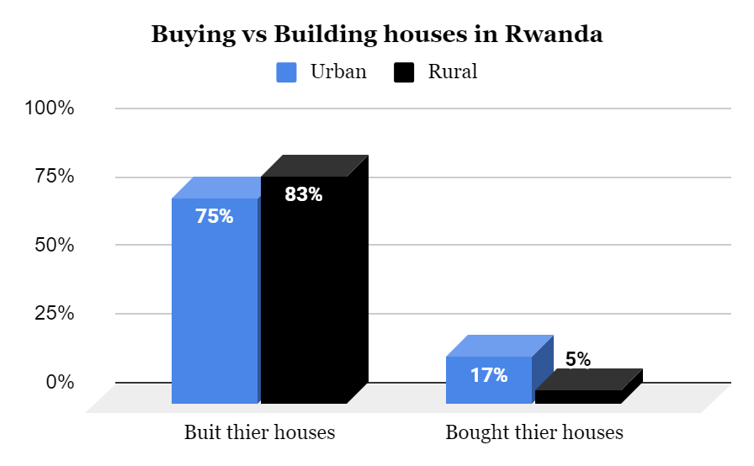
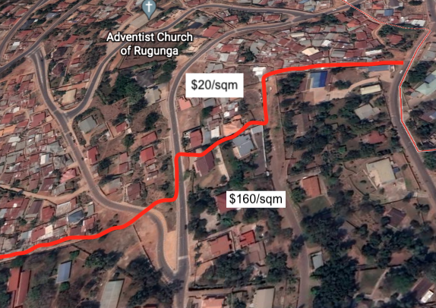
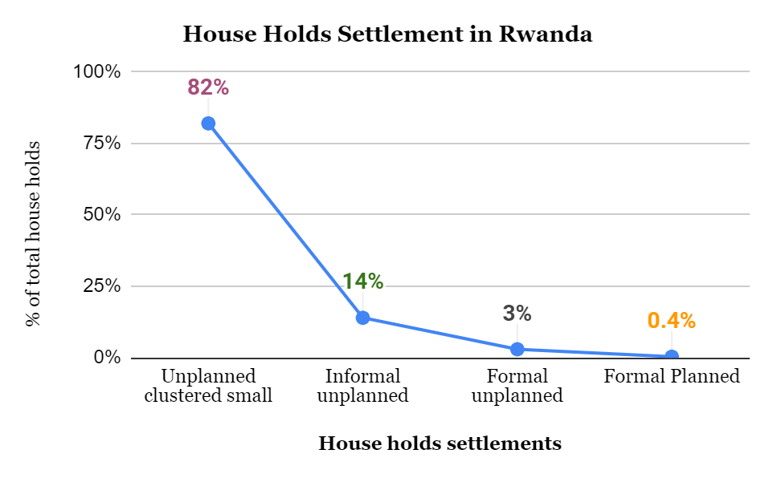
RWANDA HAS ALL THE NECESSARY VALUE CHAIN COMPONENTS TO UNLOCK THE FORMAL PLANNED SETTLEMENT
but
THERE IS LACK OF INFORMATION and NO CONNECTION AMONG REAL ESTATE STAKEHOLDERS
Leads to
Poor knowledge on parcels valuation
Problem Statement
Notes:
kuli slide tuza hindura dushyireho data

Slide 5
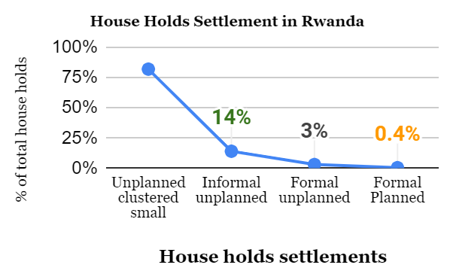
RWANDA HAS ALL THE NECESSARY VALUE CHAIN COMPONENTS TO UNLOCK THE FORMAL PLANNED SETTLEMENT
but
THERE IS LACK OF INFORMATION and NO CONNECTION AMONG REAL ESTATE STAKEHOLDERS
Poor knowledge on parcels valuation
Problem Statement
Notes:
kuli slide tuza hindura dushyireho data

Slide 6
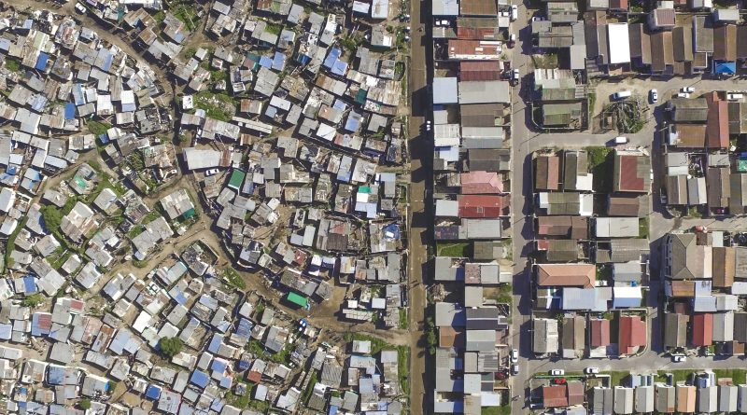
The following challenges are caused by a lack of information and disorganization among real estate stakeholders:
Homebuyers lack an ecosystem that allows them to access to information on real estate investment , such as collective housing investment
Investors find it hard to access well-researched information about real estate and guaranteed efficient investment and Development Feasibility.
75 % of homeowners in urban areas and 83 % of homeowners in rural areas build houses for themselves due to expensive construction agencies
Plot owners with small, fragmented plots and they lack knowledge on property valuation
The System is unorganized and suffers from information asymmetries and poor collaboration
Real estate investors lack access to an ecosystem that would allow them to Scale projects in a more secure and efficient manner.
… and as result 82% of total houses live in
Problem Breakdown
Notes:
.
Plot owners have small, fragmented plots, and they don't have access to an ecosystem that allows them to collaborate and attract investors to their properties

Slide 7


Buyers
Contractors
Suppliers
Engineers & Architects
Smart App
Banks
Agents
Investors
Landowners
Proposed Solution

Slide 8
WE NEED TECHNOLOGY TO UNLOCK REAL ESTATE POTENTIAL IN RWANDA,
CREATE A PLATFORM THAT BRINGS THE STAKEHOLDERS TOGETHER
AND
CREATE A DATA-DRIVEN ANALYSIS AND DECISIONS.
Technology in Rwanda
Rwanda has advanced in the world's transition to a digitalized era, with the majority of services delivered online. It is a leading technology country in east Africa, with 95% of 4G LTE network coverage.
To provide investors with data-driven information about Rwandan real estate.
Fast and Simple Property Evaluation
Understanding Customer's needs
81% of mobile penetration
Digital Master plan
Connecting Stakeholders in Real estate
Crowdfunding
Consultancy
11,562,340 parcels in Rwanda are registered digitally
The "Irembo" platform is used to deliver over 100 government services.
Why Technology

Slide 9
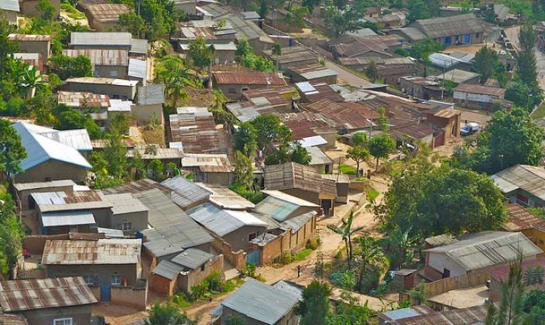
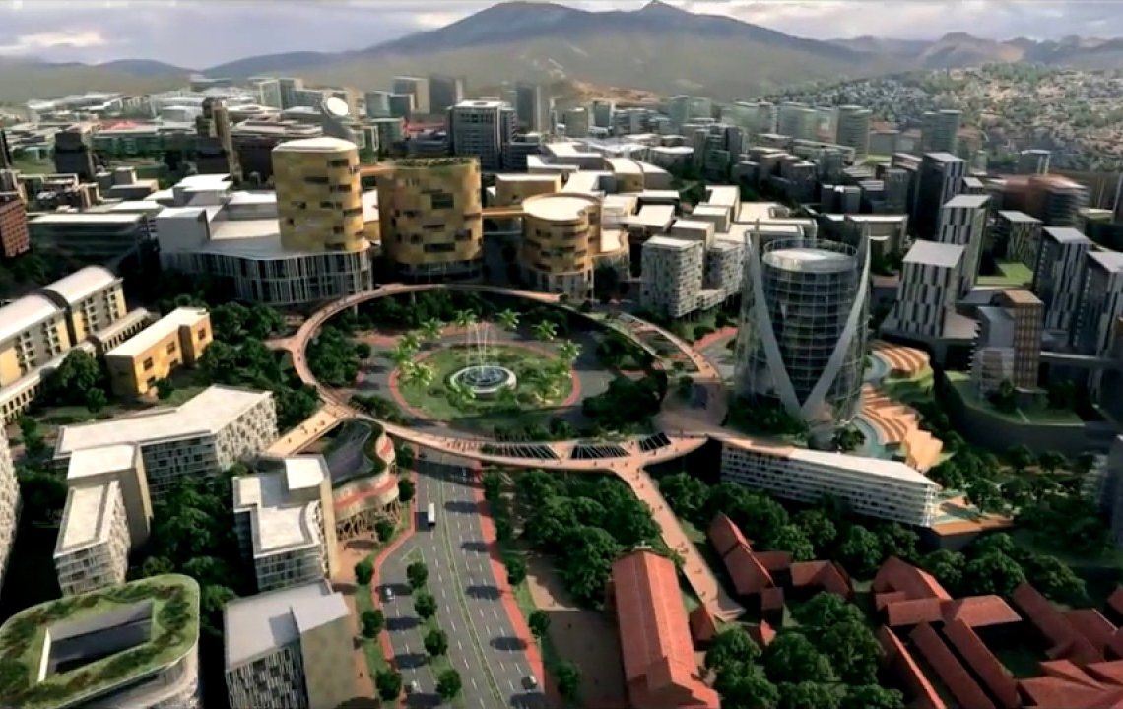
UNLOCKING THE OPPORTUNITY USING TECHNOLOGY
self owned
Collective Ownership
CrowdFunding

Slide 10
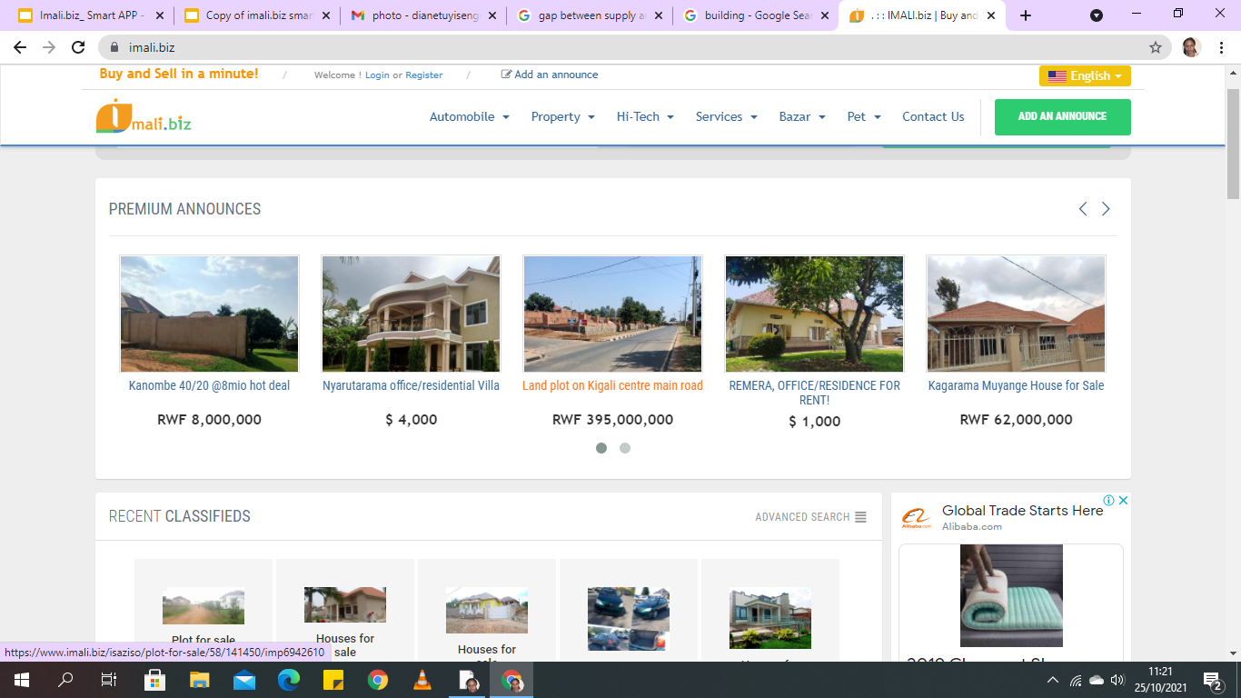
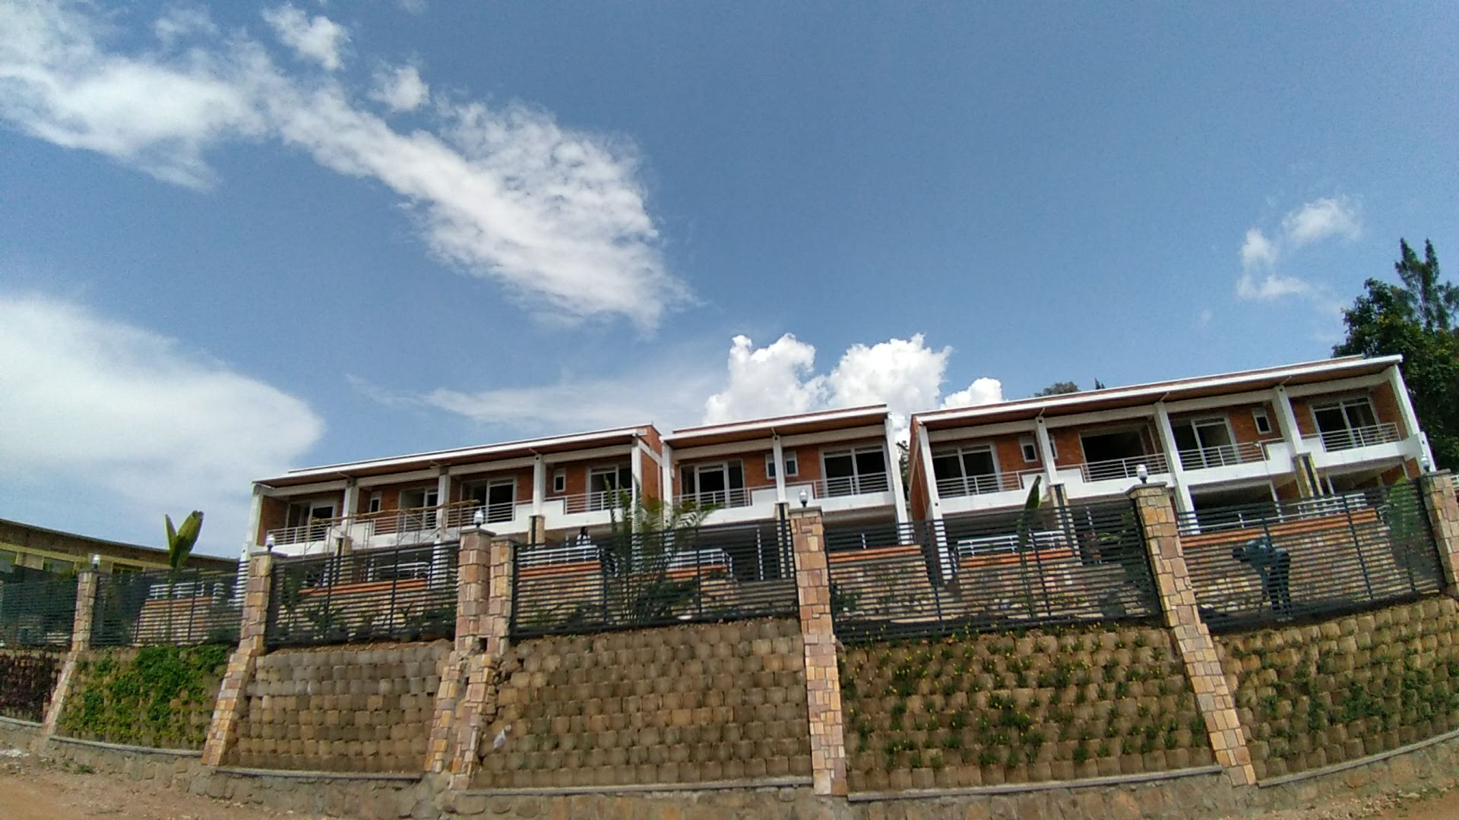
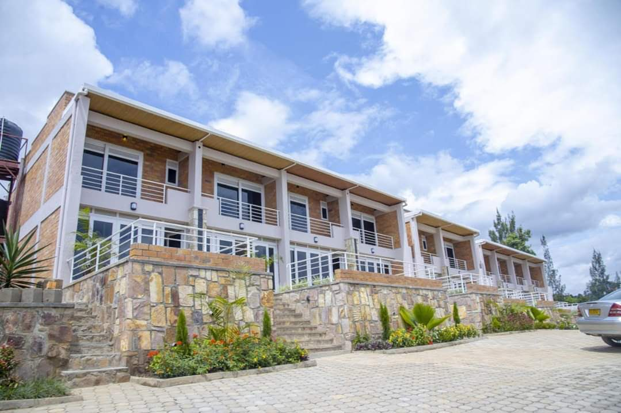
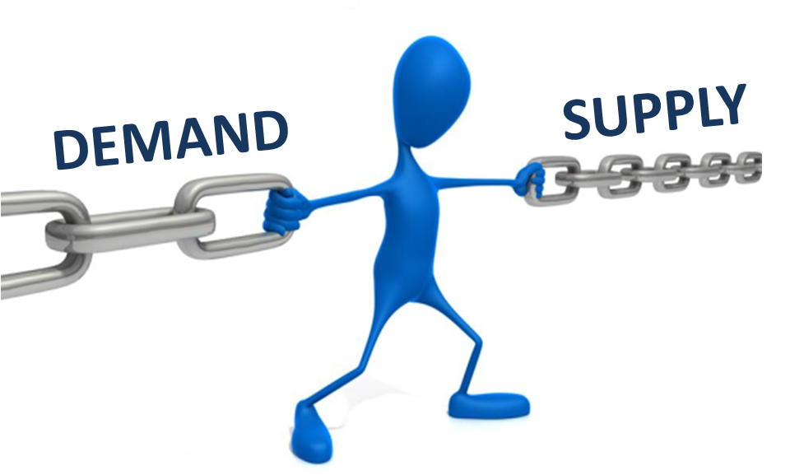
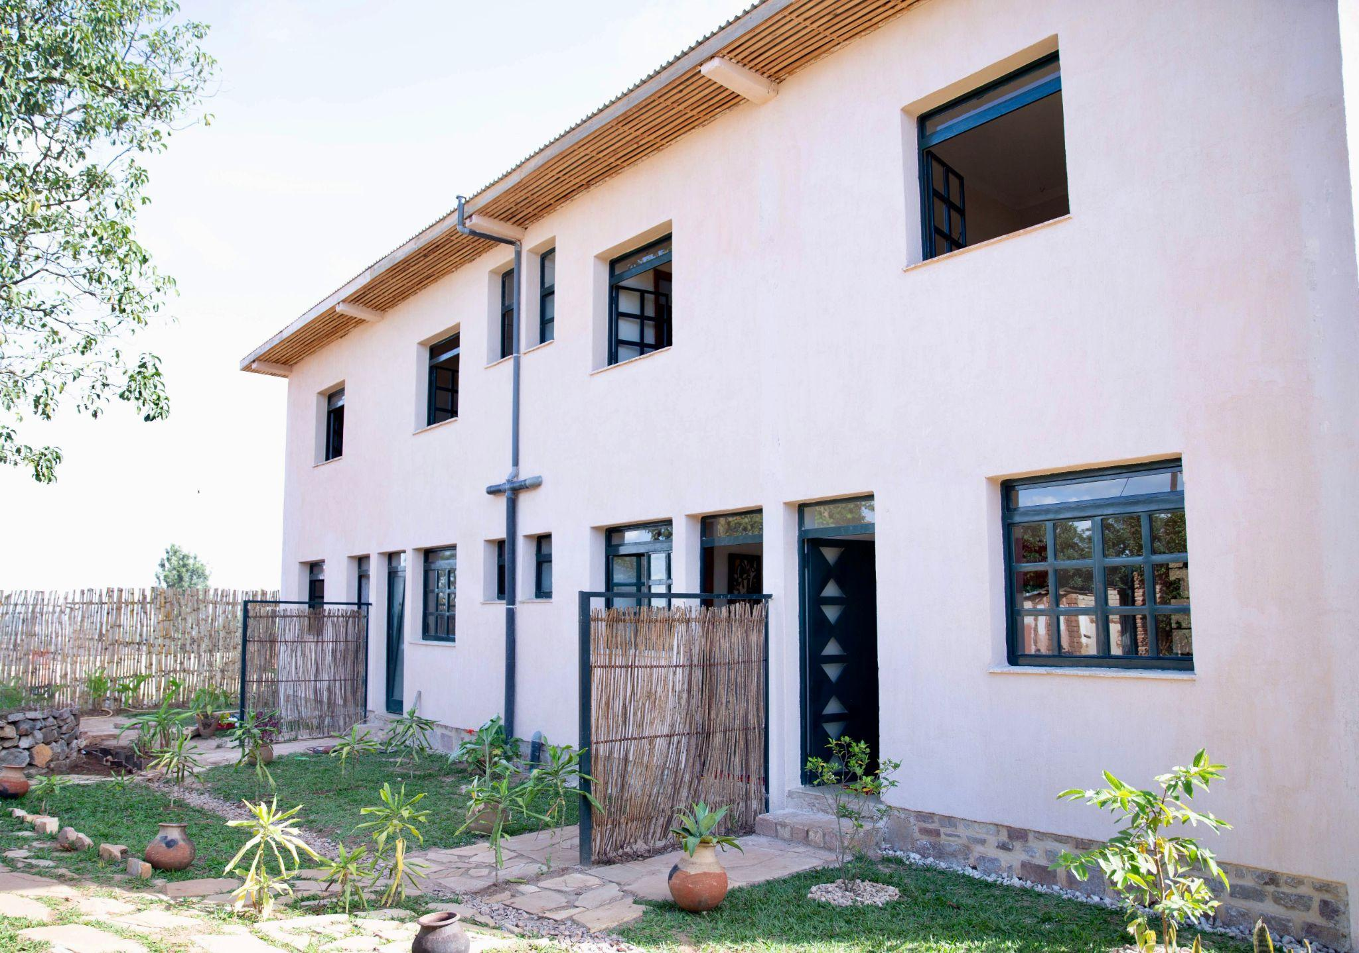
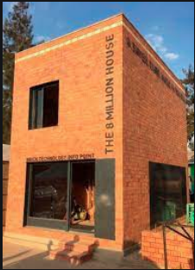
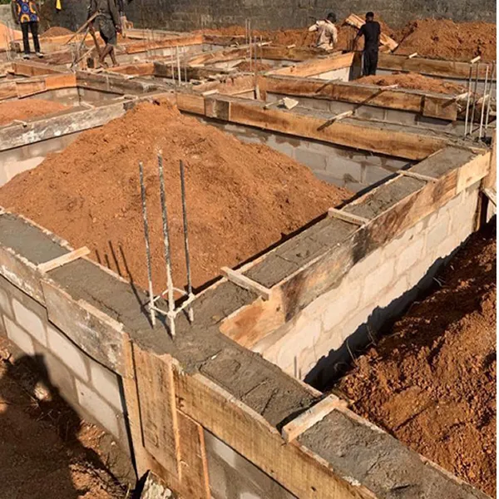
2010 introducing Technology in Real Estate
2018 We built 10 complex apartment in Remera
2016 Expo Survey on Real Estate in Rwanda
2019 We built complex apartment in Rebero
2015 We Identified Huge gap between Supply and demand of Real estate in Rwanda
2020, we completed the first phase 26 on Going project affordable housing project in Kigali.
2018 BI Sample of Affordable housing In Gikondo worth 8 Million
Present (2021)
on Going project of 26 flats of Affordable Housing
Traction

Slide 11
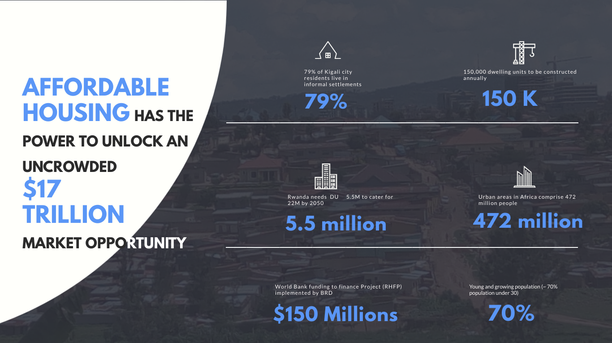

Slide 12
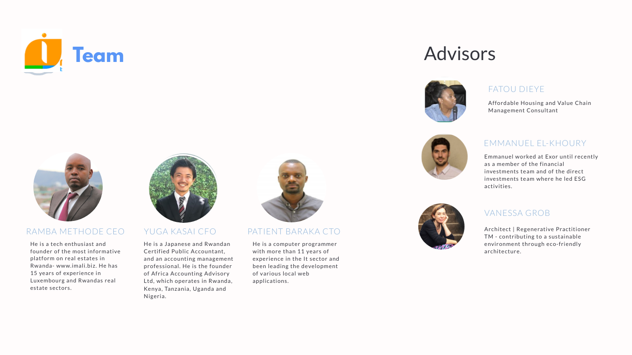

Slide 13
REVENUE MODEL
LANDOWNER
LAWYERS/ENGINEERS/ARCHITECTS
SUPPLIER
HOMEBUYERS
COMMISSION 5%
AFFILIATION
AFFILIATION
COMMISION 5%
Deal
Facilitation
Customer Data
Customer Data
Customize Home
MASS CUSTOMIZATION
Automated dispatch
OPTIMIZATION
PERFORMANCE CONTRACTING
PERSONALIZED SUPPORT
VIRTUALIZATION
Design and construction
USER DESIGN
DISINTERMEDIATION
PERSONALIZED GUIDANCE
CONSOLIDATION
Valuation
PERSONALIZED
GUIDANCE
PERSONALIZED
SUPPORT
SMART CONTRACT
Automated dispatch
LEVERACE
PERFORMANCE CONTRACTING
CROWDSOURCING SUPPORT

Slide 14
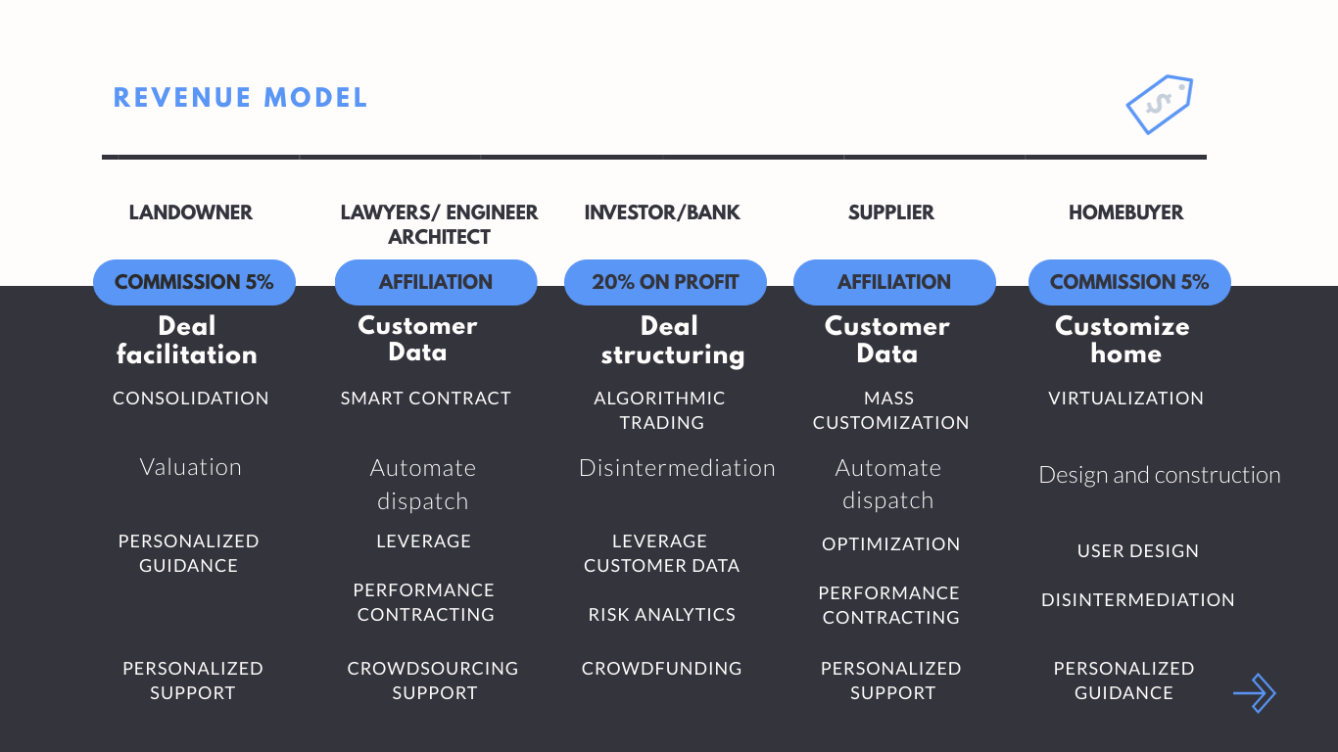
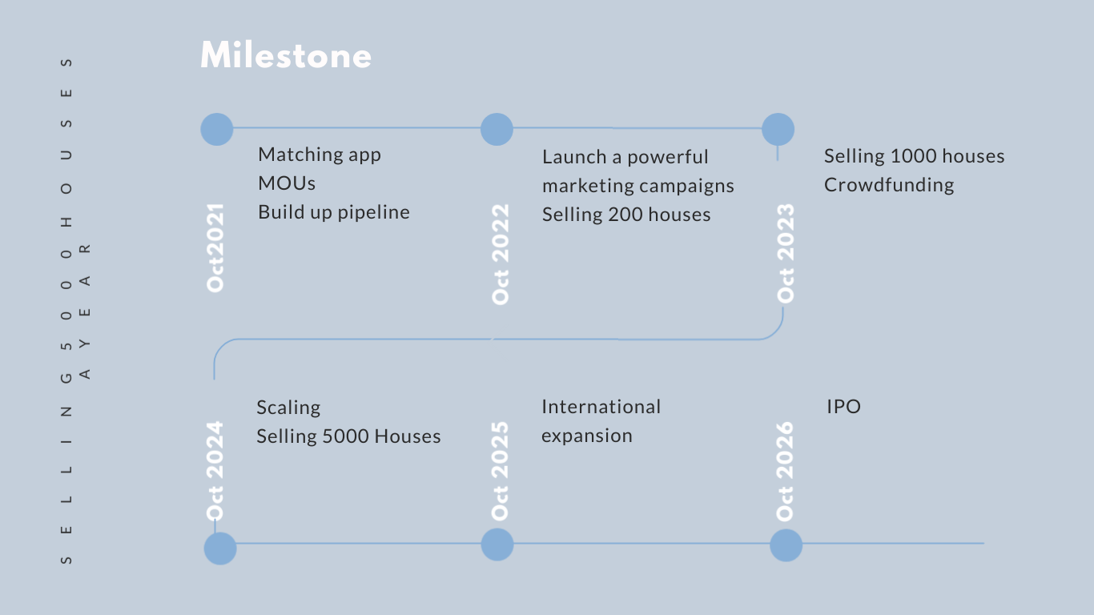

Slide 15
WE ARE LOOKING FOR $1.000.000 FUNDS FOR SMART DEVELOPMENT AND CONSULTING TO UNLOCK ILLIQUID ASSETS
we unlock Illiquid Assets
LAND WORTH $10 MILLION
CONSTRUCTION MATERIALS WORTH 35 MILLION
Smart App and analytics Platform development
Contracting Stakeholders
Off Plan Design
Virtualization
Building Pipeline
Market Research
Launch marketing campaigns and enrol off-plan buyer
SIGN WITH 4235 HOMEBUYERS
$ 2.11 MILLION

